Slide 1
RICE MACT and Oil Analysis
Michael Holloway, CLS
Notes:
The EPA has new National Emission Standards for Hazardous Air Pollutants (NESHAP) for certain stationary engines that will go into effect as of October 19, 2013. The new EPA regulations come under RICE MACT rules, which apply to any piece of equipment driven by stationary reciprocating internal combustion engines located at a major source of hazardous air pollutants (HAP).“RICE MACT” refers to “Reciprocating Internal Combustion Engines” (RICE) and “Maximum Achievable Control Technology” MACT). For all the details involved with the new rules there is an abundance of information available on the web.

Slide 2
What is the RICE MACT?
The National Emission Standards for Hazardous Air Pollutants (NESHAP) for Reciprocating Internal Combustion Engines (RICE). Often called the RICE MACT or GACT
- MACT - Maximum Achievable Control Technology for Major Sources of Hazardous Air Pollutants (HAPs)
- GACT - Generally Achievable Control Technology for Area Sources
of HAPs
The purpose of RICE MACT is to reduce the emissions of Hazardous Air Pollutants (HAPs) from reciprocating internal combustion engines.
Major industrial sources that emit 10 tons a year or more of a single Hazardous Air Pollutant or 25 tons a year or more of a combination of Hazardous Air Pollutants.
Notes:
On February 17, 2010, EPA finalized portions of the National Emission Standards for Hazardous Air Pollutants for Reciprocating Internal Combustion Engines (RICE NESHAP). The rule was promulgated into the existing RICE standards located in 40 CFR Part 63, Subpart ZZZZ on March 3, 2010. The newly incorporated standards were originally proposed on February 25, 2009 and apply only to stationary RICE. The proposed standards included provisions for RICE located at area sources of hazardous air pollutants (HAPs) and RICE with a site rating of ≤ 500 brake horsepower (bhp) located at major sources of HAPs. In addition, the proposal included standards for existing non-emergency compression ignition (CI) engines with a site rating of > 500 bhp at major sources and revised provisions related to Startup, Shutdown, and Malfunction (SSM) events for engines previously regulated under the rule.
Under the NESHAPs, a major source is defined as a site that emits > 10 tons per year (tpy) of any single HAP or > 25 tpy of combined HAPs. An area source is a site that emits HAPs, but is not considered a major source. A list of pollutants considered to be HAPs can be found at epa.gov/ttn/atw/orig189.html
Under these new regulations, many previously unregulated engines, including those designated for emergency use, are subject to federal regulation, including emission standards, control requirements, or management practices.

Slide 3
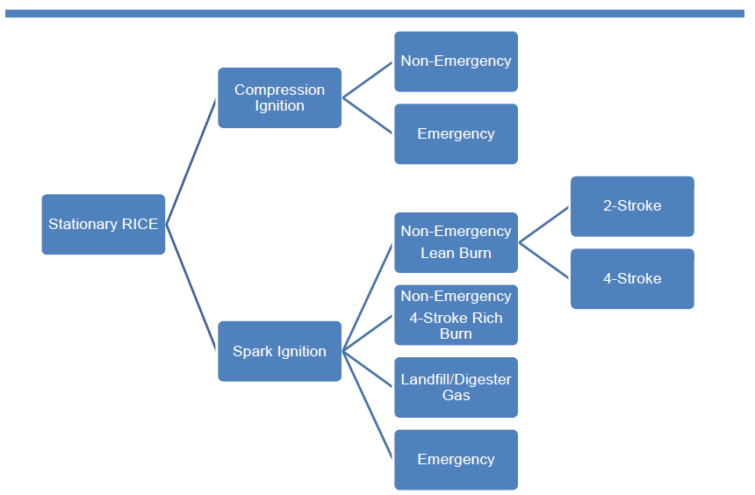
Asset Categories
Notes:
These new rules are designed to regulate emission standards for stationary reciprocating engines, which go into full effect under NESHAP Subpart ZZZZ. This new regulation will require the oil & gas industry to implement new processes when it comes to testing in-service engine oils. Oil and filter changes will be mandated depending on the Horse Power of the engine, engine design, and whether the application is emergency or non-emergency. This will impact the lubrication management practices of the natural gas conveyance industry. The use of in-service oil analysis allows for determining alternative oil change frequencies instead of the prescribed frequencies detailed in the NESHAP ZZZZ regulations.

Slide 4
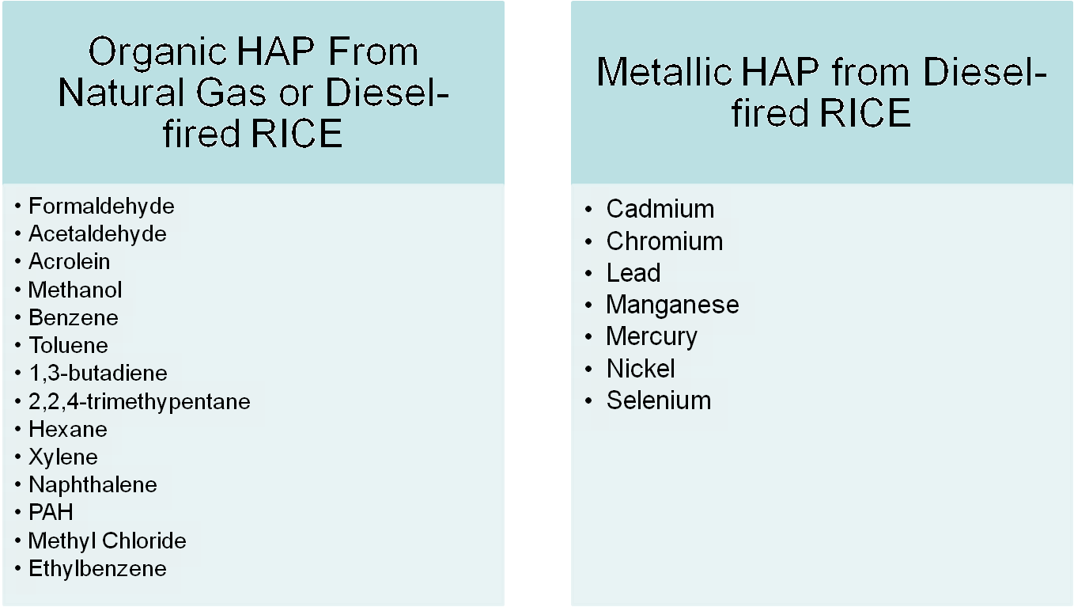
HAPs Emitted from Engines
Notes:
The compliance date for all applicable emission limitations and operating limitations for the affected units is three years from the effective date of the rule. The compliance date for the sources affected by the current revision to the rule is May 3, 2013. Following is a summary of the updated requirements for the existing stationary CI engines incorporated into the RICE NESHAP during this latest rule revision.
In addition to the requirements listed in the Updated MACT ZZZZ Requirements for Existing Stationary Reciprocating Internal Combustion Engines Table, EPA finalized startup requirements for the following stationary engines:
■Existing CI RICE ≤ 500 hp at major sources
■Existing non-emergency CI RICE > 500 hp at major sources
■Existing CI RICE at area sources
■New or reconstructed non-emergency two stroke lean burn (2SLB) < 500 hp at major sources
■New or reconstructed non-emergency four stroke lean burn (4SLB) ≥ 250 hp at major sources
■Existing, new, or reconstructed non-emergency four-stroke rich burn (4SRB) > 500 hp at major sources
■New or reconstructed non-emergency CI > 500 hp at major sources

Slide 5
Why RICE MACT?
The purpose of RICE MACT is to reduce the emissions of Hazardous Air Pollutants (HAPs) from reciprocating internal combustion engines (RICE) located at major industrial sources of air HAPs or area sources.
Notes:
Owners and operators must minimize the engine’s startup period to the amount of time needed for appropriate and safe loading of the engine, not to exceed 30 minutes. After this time, the engine must meet the numerical emission standards, if applicable.

Slide 6
Who Does It Affect - Stationary RICE Source Categories
Emergency stationary RICE
Limited use stationary RICE
Stationary RICE that combust landfill gas or digester gas equivalent to 10 percent or more of the gross heat input on an annual basis
Compression Ignition (CI) (Diesel)
Spark ignition 4-stroke rich burn (4SRB)
Spark ignition 2-stroke lean burn (2SLB)
Spark ignition 4-stroke lean burn (4SLB)

Slide 7
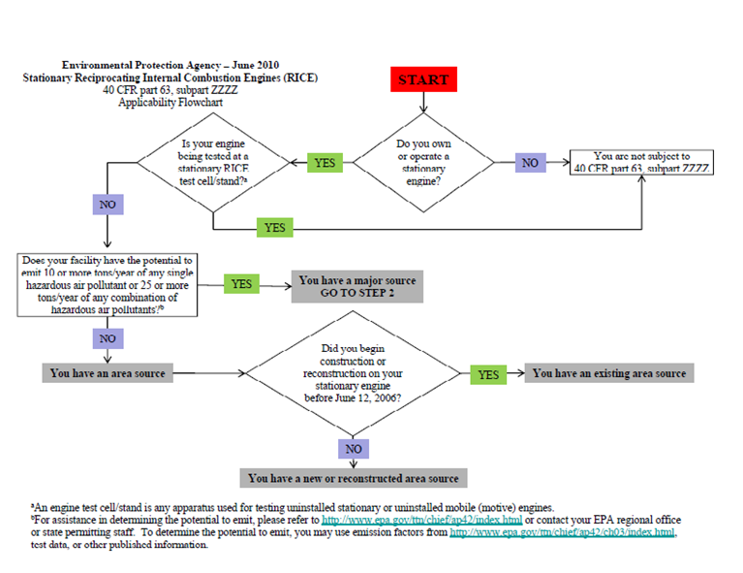
How Do I Know If RICE MACT Is For Me?

Slide 8
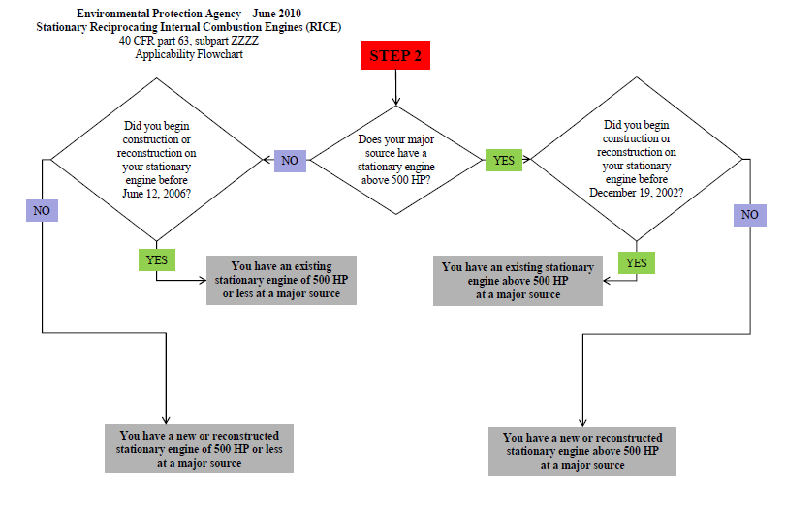
10+ Tons HAPS on Single Unit, 25+ Tons Combo

Slide 9
RICE MACT Emission Requirements
Existing and new 4-stroke rich burn (4SRB) engines either reduce formaldehyde by 76% or limit the formaldehyde concentration to 350 ppb.
New 2-stroke lean burn (2SLB) engines either reduce carbon monoxide (CO) by 58% or limit the formaldehyde concentration to 12 ppm.
New 4-stroke lean burn (4SLB) engines either reduce CO by 93% or limit the formaldehyde concentration to 14ppm.
New compression ignition (CI) engines either reduce CO by 70% or limit the formaldehyde concentration to 580 ppb.

Slide 10
Types of RICE MACT Requirements
Notifications
Emission Limitations
Controls
Operating Limitations
Fuel Requirements
Performance Tests
Monitoring
Recordkeeping
Reporting

Slide 11
Management Practice
Hoses and Belts must be inspected on all of these engines after 500 hours, or annually, and replaced “as necessary.”
Air cleaners must be inspected at 1000 hours, or at least annually.
Oil and Filters must be replaced at 500 hours, or annually, except for non-emergency engines smaller than 100 HP at major sources or smaller than 300 HP at area sources where this inspection can be deferred until 1000 hours.
For engines with a compliant oil analysis program, these limits may be extended.

Slide 12
Exempt from RICE MACT
If and only if the engine operates as an emergency engine under the rule and is located at residential, institutional, or commercial establishments that are area sources for HAPs
Residential could be an apartment complex or a house
Institutional establishments means places such as general medical centers and hospitals, nursing homes, research centers of higher education, correctional facilities, schools, libraries, police and fire stations, physicians and health specialist offices
Commercial could be office buildings or telecommunication tower sites

Slide 13
What qualifies a limited use stationary RICE?
Limited use and emergency stationary RICE = Less than 100 hours per year.
An Emergency Stationary RICE has…
No limit on use during emergency situations.
Maintenance checks and readiness testing are limited to 100 hours/year
Up to 50 hours/year of non-emergency operation is allowable (counts toward the 100 hours/year)
The 50 hours/year cannot be used for peak shaving or to generate income except for up to 15 hours/year for demand response when a regional transmission operator is in danger of a blackout

Slide 14
Stationary RICE that combust landfill gas or digester
Gas Equivalent to 10% or more of the gross heat input…
Landfill Gas: the gaseous by-product of the land application of municipal refuse typically formed through the anaerobic decomposition of waste materials and is composed primarily of methane and CO2.
Digester Gas: the gaseous by-product of wastewater treatment typically formed through the anaerobic decomposition of organic waste materials and is composed primarily of methane and CO2.
For each Stationary RICE that combust landfill gas or digester gas equivalent to 10 percent or more of the gross heat input on an annual basis installed after the compliance date is subject to Subpart ZZZZ (4Z), you must submit an initial notification and monitor, record and report annual fuel usage.

Slide 15
Oil Analysis and RICE MACT
Notes:
Sources can extend the period for changing the oil if the oil is part of an oil analysis program and no condemning limits are exceeded. Analyses must be conducted at the same frequency specified for changing the oil.
For those engines that require periodic oil changes, the schedule for changing engine oil can be extended if the oil is part of an oil analysis program. The program must include analyzing the following parameters in order to qualify: Total Base Number, viscosity, and percent water content. If certain limits are met during the analysis, then the owner or operator is not required to change the oil. However, if any of the limits are exceeded, the oil must be changed prior to continuing use of the engine.
Testing of the used engine oil provides a tool for documenting compliance of the oil change requirements as well as allowing for drain intervals that may be more favorable to maintenance practices. ALS test reports provide horsepower ratings on applicable equipment when this information is provided. Diagnostics protocols can then note a “RICE MACT Alert!” on applicable test reports. This would involve mandatory re-testing of the data outlier to confirm original data reported and recommending an immediate oil change if not done at time of sampling. Alerts would be based on test parameters for viscosity, acid number, and water contamination outlined under NESHAP ZZZZ regulations. Operators will have two business days to change their oil or take the unit out of operation upon receipt of the RICE MACT Alert sample analysis.

Slide 16
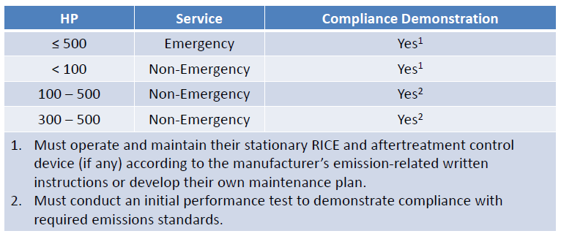
Compliance Demonstration – Major Source

Slide 17
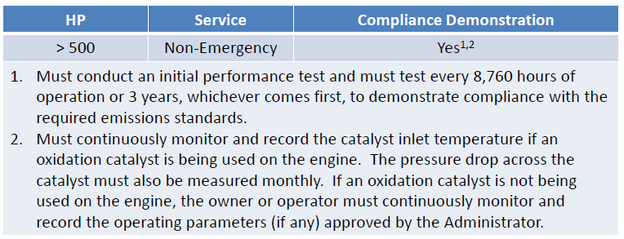
Compliance Demonstration - >500hp Major Sources

Slide 18
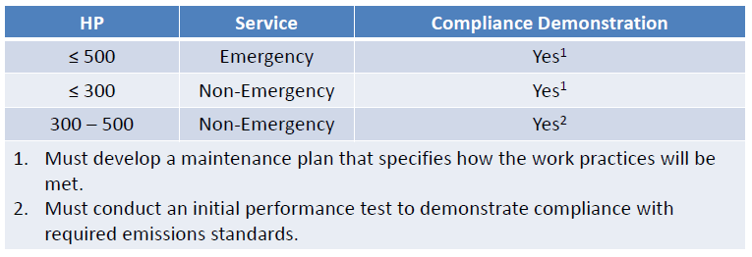
Compliance Demonstration - ≤ 500hp Area Sources

Slide 19
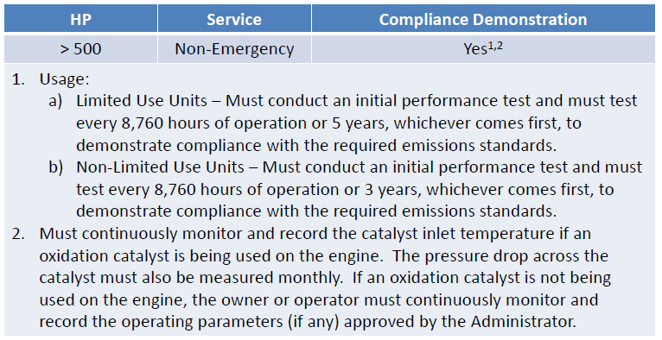
Compliance Demonstration - > 500hp Area Sources

Slide 20
Record Keeping & Recording
Recordkeeping is required.
Records must include hours of operation per a non-resettable hour meter, oil and filter change dates, inspection and replacement of air cleaners, hoses and belts, and other emission related service, all by date and.
Records of maintenance per manufacturer’s requirements are also required for crankcase systems (closed ventilation or open filtration) for covered engines.
Notes:
In addition, recordkeeping and reporting requirements for many engines are included in the final rule. All owners and operators of existing stationary RICE, with the exception of RICE < 100 hp, existing emergency stationary RICE, and existing stationary RICE that are not subject to numerical emission standards, must submit all applicable notifications as listed in the §63.6645 and NESHAP General Provisions (40 CFR Part 63, Subpart A).
Sources with affected RICE should review the final rule carefully to determine compliance requirements based on the promulgated standard. For more information or to view a copy of the final rule, go to the epa.gov/ttn/oarpg/new.html.

Slide 21
Record Keeping & Reporting
Reporting is required for stationary CI RICE on a semi-annual basis (or annual basis for limited-use) , as listed in the NESHAP General Provisions, 40 CFR part 63, subpart A, including initial notification, notification of performance test, and notification of compliance.
Deviations and malfunctions must also be reported.
Annual fuel consumption and heating value reports are also required.

Slide 22
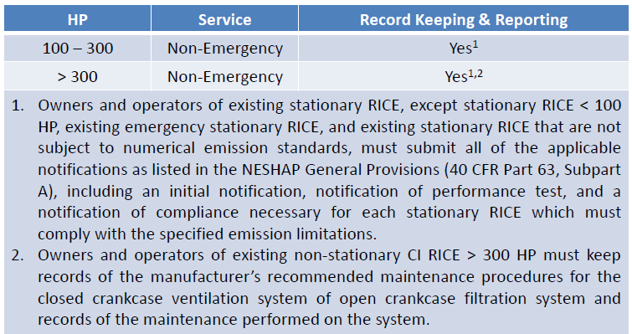
Record Keeping & Reporting – Major Sources

Slide 23
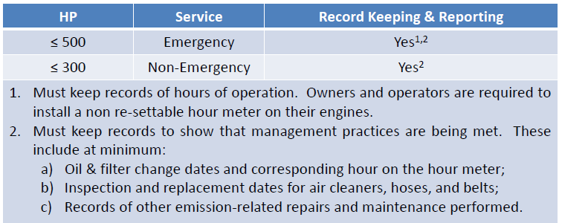
Record Keeping & Reporting – Area Sources

Slide 24
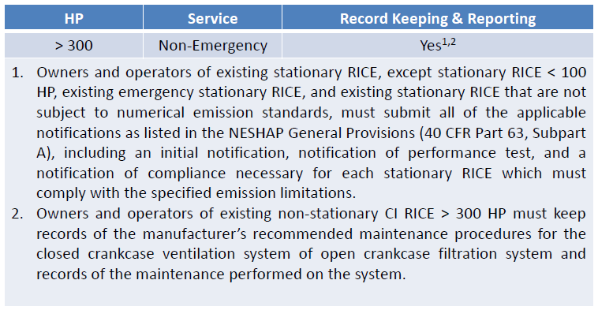
Record Keeping & Reporting – Area Sources

Slide 25
Best Management Practices Requirements
Change oil filter annually or every 1,000 hours of operation
Inspect the air cleaner (filter) annually or every 1,000 hours of operation
Inspect all hoses and belts annually or every 500 hours of operation
Records need to be kept for five years
Duration of startup and shutdown time to less than 30 minutes per event

Slide 26
Oil Analysis and RICE MACT
What to Expect From the Lab…
Change Oil or shut down unit within 2 business days (not 48 hours) upon receipt of a RICE MACT ALERT Severe report.
RICE MACT Notice will always be SEVERE but you can have a SEVERE and not be a RICE MACT.
Viscosity Testing to be done at 100C.
PQ Particle testing to be done (not a RICE MACT) replaces the 40C viscosity testing.

